Slide 1

Navigate your path to graduate admission

Slide 2
Entrepreneurship Pitch Deck
Group Members
Danial Ahmad
Muhammad Ahmed Mohsin
Muhammad Ali Farooq
Muhammad Umer
Syeda Fatima Zahra

Slide 3

Problem
Students feel lost in the Grad School Maze!
The graduate school application process is complex and confusing
Unlike undergraduate admissions, graduate admissions are field-specific and put a far greater emphasis on research
Students struggle to
Identify research interests
Find relevant programs and professors
Connect with experienced mentors

Slide 4
The Solution: GradCompass
GradCompass aims to be a personalized guide for prospective graduate school applicants
Empower students with the resources and support their need
Features
AI-powered Comparison Tool | Personalized Mentorship & Guidance
Generates comprehensive comparison based on student preferences Provides detailed information on programs, core research areas, active faculty, funding/stipends, and more Saves time and effort, enabling informed decision-making and providing convenience | Connects students with experienced mentors for one-on-one guidance Offers support with essays, research proposals, interview preparation, and career advice Comprehensive blogs/webinars aimed at boosting student confidence and writing skills

Slide 5
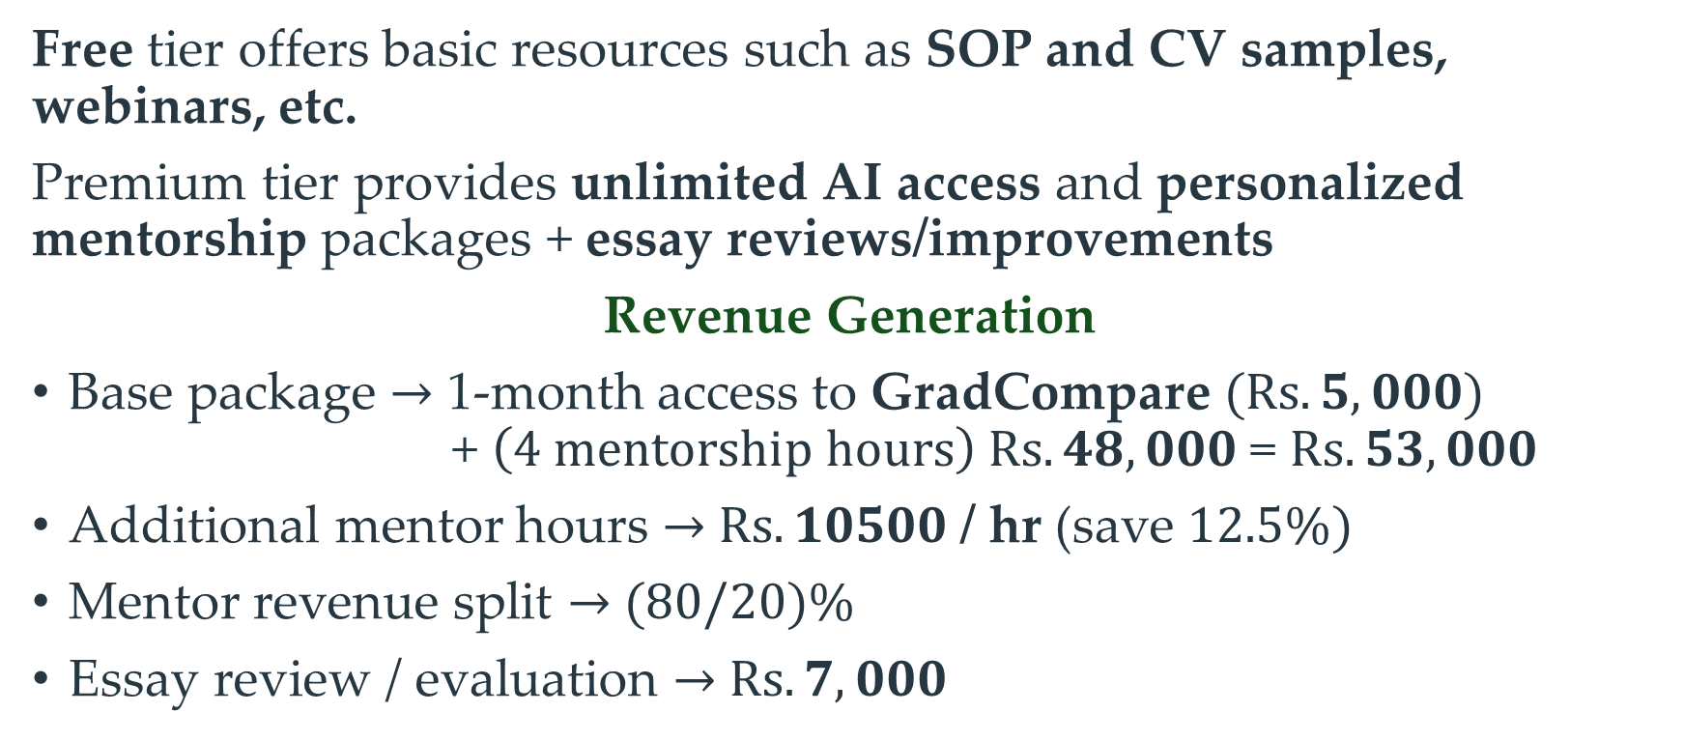
Business Model (Freemium)
Free tier offers basic resources such as SOP and CV samples, webinars, etc.
Premium tier provides unlimited AI access and personalized mentorship packages + essay reviews/improvements
Revenue Generation
Base package $→$ 1-month access to GradCompare $(Rs. 5,000)$ + $\left(4 mentorship hours\right) Rs. 48,000$= $Rs. 53,000$
Additional mentor hours $→$ $Rs. 10500$/ hr (save $12.5\%)$
Mentor revenue split $→$ $(80/20)\%$
Essay review / evaluation $→$ $Rs. 7,000$

Slide 6
Unique Selling Proposition (USP)
Why Choose GradCompass?
GradCompass is a one-stop-shop for graduate school applicants
Graduate Studies!
Our focus is on MS and PhD Emphasis on research
Comprehensive
All the resources you need in one place
Innovation
AI powered “Retrieval-Augmented Generation (RAG)”

Slide 7
Porter’s Five Forces
Threat of New Entrants
Educational consulting industry is relatively easy to enter, but it can be difficult to establish a strong brand and large network
Bargaining Power of Buyers
Students have few options to choose from when it comes to graduate school guidance platforms
Bargaining Power of Suppliers
There are a variety of suppliers of resources and services that can be used to create a graduate school guidance platform
Threat of Substitutes
There are a few substitute products and services available, such as graduate school guidebooks and online forums
Competitive Rivalry
The educational consulting industry is a competitive landscape, with several established players but no one is specifically focusing on graduate admissions

Slide 8

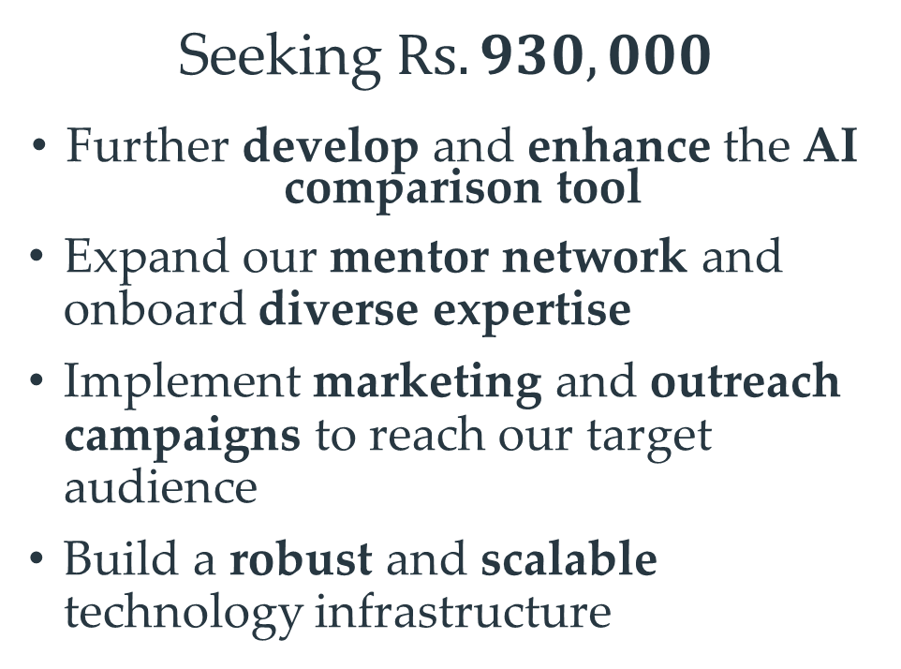
Funding (The Need)
Gemini API Pricing (Pay-as-you-go)
Rate Limits*#
10 RPM (requests per minute) 10 million TPM (tokens per minute) 2,000 RPD (requests per day)
Price (input)
$7 / 1 million tokens (preview pricing)
Price (output)
$21 / 1 million tokens (preview pricing)
Seeking $Rs. 930,000$
Further develop and enhance the AI comparison tool
Expand our mentor network and onboard diverse expertise
Implement marketing and outreach campaigns to reach our target audience
Build a robust and scalable technology infrastructure
From Gemini API pricing, $\$28 / 1$million tokens
Using a conservative value of $250k$ tokens / 100 “Generate comparisons …”, we estimate $\$7$ or $\sim Rs. 2,000$ per student

Slide 9


AI Comparison Tool
Usage Demo
Powered by
GradCompare by GradCompass
Open in Browser

Slide 10
